Slide 1
Haldun GÜNDOĞDU
Scientific Secretary
General Surgery - Gastrointestinal Surgery
Atatürk Teaching and Research Hospital

Slide 3
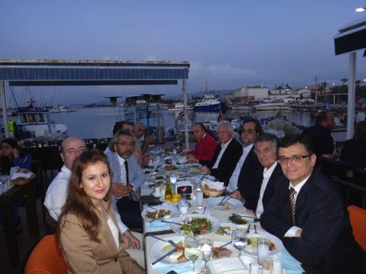
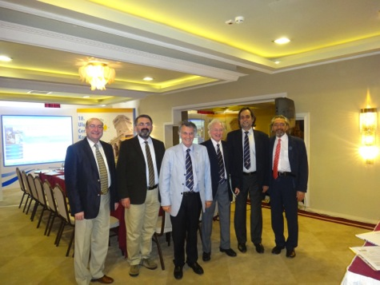
Organization

Slide 4
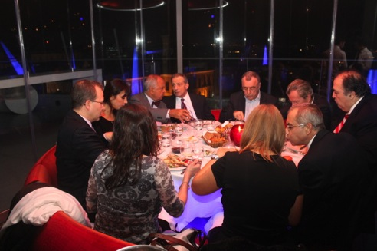
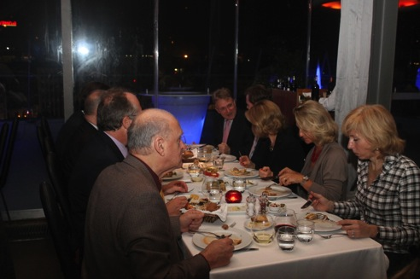
Organization

Slide 5
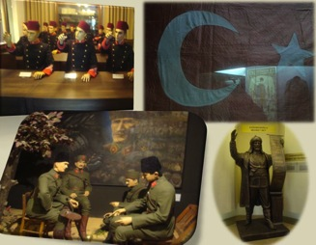
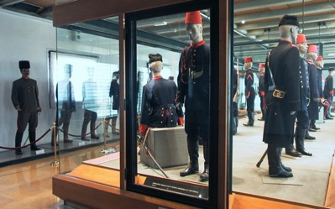
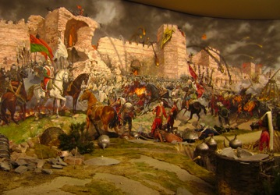
Askeri Museum Cultural Center

Slide 6
Janissary Band = Mehter Takımı

Slide 7
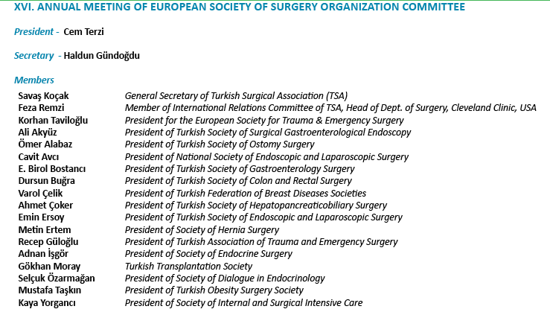

Slide 9
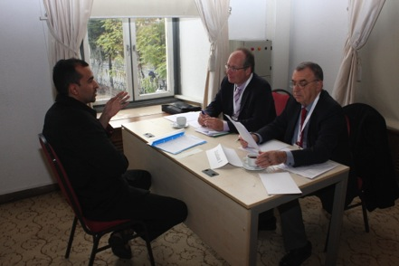
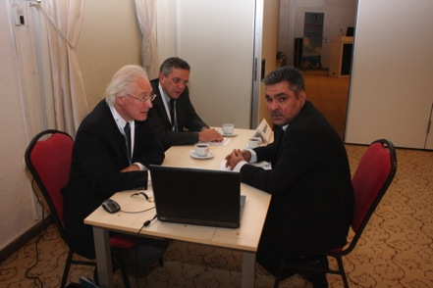
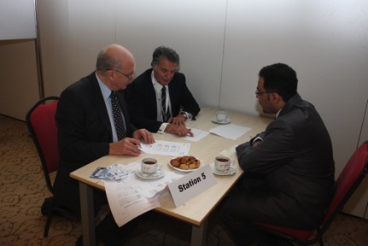
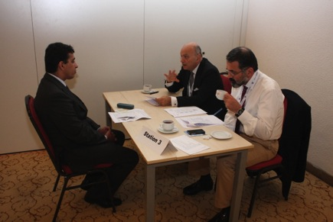
UEMS Board Examination

Slide 10
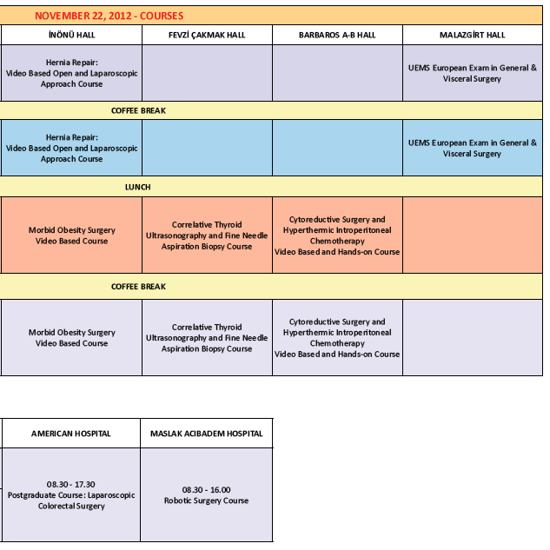

Slide 11
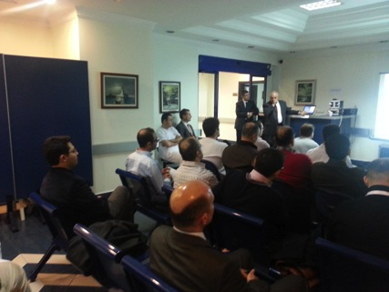
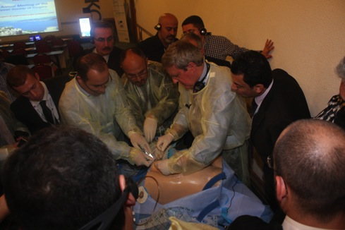
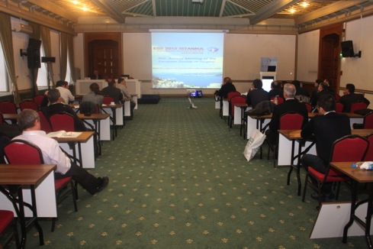
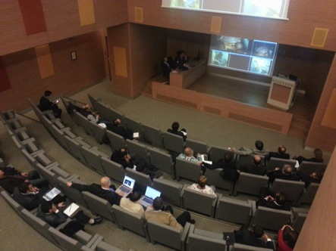

Slide 12
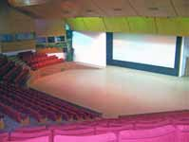
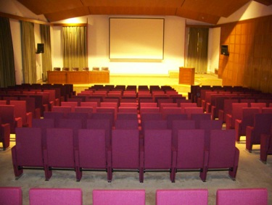
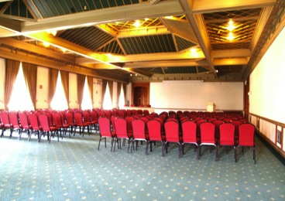
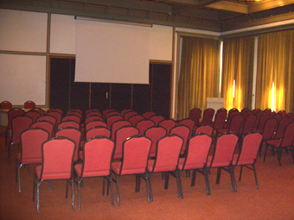
30 Ağustos Meeting Hall
İnönü Meeting Hall
Kocatepe Meeting Hall
Fevzi Çakmak Meeting Hall

Slide 13
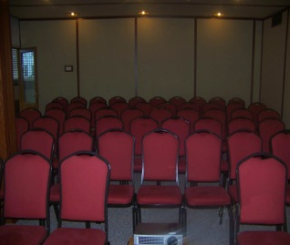
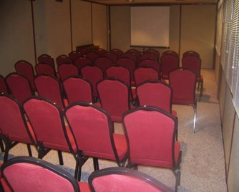
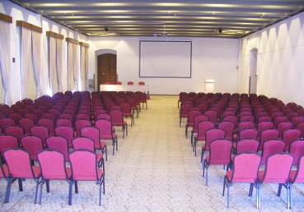
Sakarya Meeting Hall
Malazgirt Meeting Hall

Slide 14
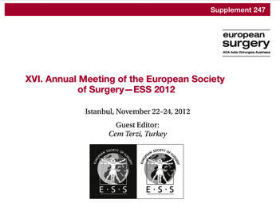
982 abstracts
First 200 : European Surgery
116 oral
84 poster
Accepted: 840
Acceptance rate: 85.5%

Slide 15
COURSES 9
WORKSHOP 1
INVITED PRESENTATIONS 1
ORAL PRESENTATIONS 16
VIDEO SESSION 2
LECTURE 16
PLENARY SESSION 6
DEBATE 3
VIDEO BASED EDUCATION SESSION 3
MINI PROGRAM 1
SATELLITE SYMPOSIUM 2
PANEL DISCUSSION 1

Slide 16
Faculty
USA 6 United Kingdom 4
Germany 3 Greece 3
Austria 3 Poland 2
Italy 2 Malta 2
Belgium 1 Denmark 1
Czech Rep. 1 Finland 1
Spain 1 Sweden 1
Serbia 1 Georgia 1
Turkey

Slide 17
ETHICON
SPONSORS
We thank all the sponsors for their supporting contributions.
KCI

Slide 18
COVIDIEN
SYSTAGENIX
3M
MEDURA SAĞLIK
HARTMANN
ROCHE

Slide 19
DOĞSAN
HİTİT MEDICAL
ABDICA
BIOLITEC
COOK
MEDICAL
PUSULA MEDİKAL
TUTKU SAĞLIK
CONVATEC
INTRA
STRYKER

Slide 20
ESS 2012 ISTANBUL COUNTRIES OF PARTICIPANTS
Albania
Argentina
Armenia
Austria
Azerbaijan
Belgium
Croatia
Czech Republic
Denmark
Dominican Republic
Egypt
Finland
Georgia
Germany
Greece
India
Iran
Ireland
Italy
Jordan
Korea, South
Kuwait
Malta
Moldova
Norway
Pakistan
China
Poland
Romania
Saudi Arabia
Serbia
Singapore
Spain
Sweden
Thailand
Türkiye
Ukraine
United Arab Emirates
United Kingdom
United States
Yemen

Slide 22
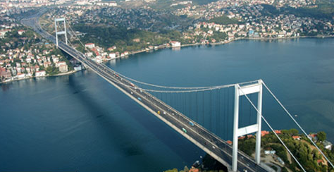
Thank you
Let’s meet where the two continents meet

